Slide 1
“Virtual Court: Receptions & Possibilities in Bangladesh.”
Presented By- Group 5

Slide 2
Virtual Court Background: When and where started.

Slide 3
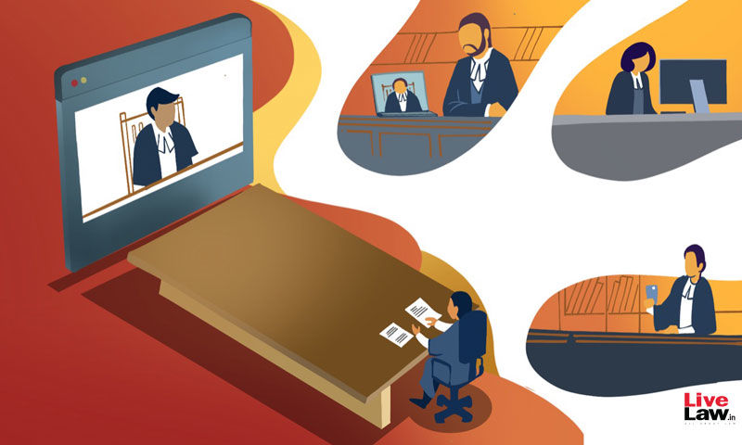

Virtual Court
What is Virtual Court?
"Virtual court," is a court of law created on a video live sharing platform between police custody suits and a magistrate courts together with Judge being held with all the E-documents, where all the relevant parties have access.
Goal: The main goal for using Virtual Court is to save time at an affordable cost and in an easily accessible way but in the most effective way to provide the same Justice as in the actual court without even going there.

Slide 4

Virtual Court
Cyber Court
≠

Slide 5
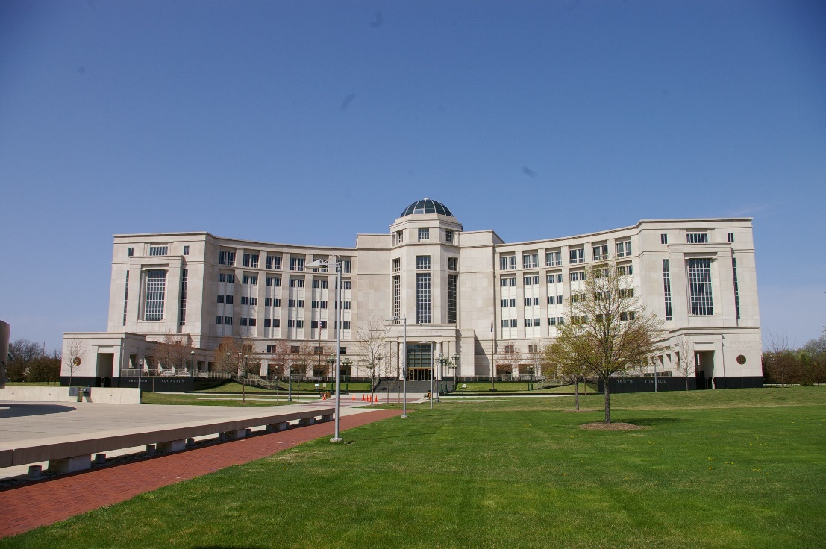
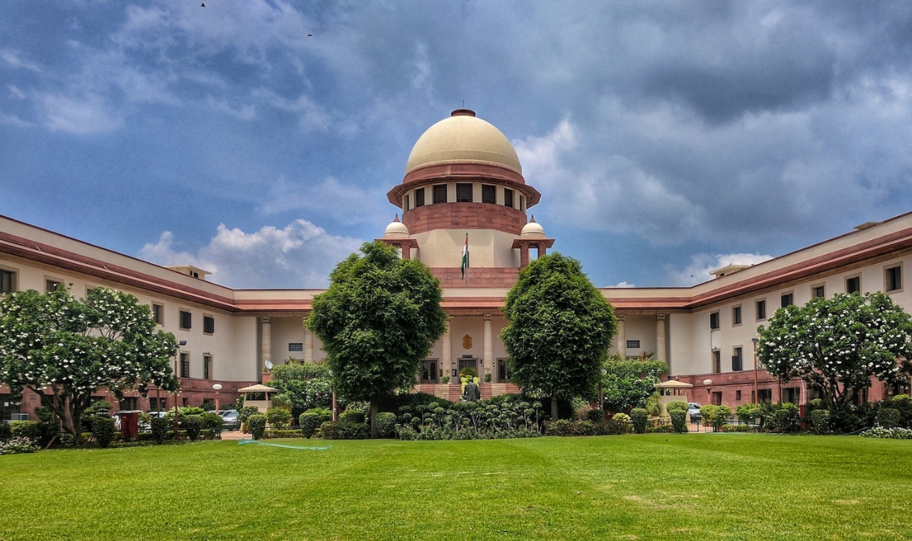
History
Virtual Court has no actual origin but the first step taken in creating a “virtual court” was actually started by the Michigan state of the U.S in 2002. But it was still held as a project and became successful years later because of the needing Fund of
$2 million.
On 2005, India started its journey In E-judiciary and through which the E-committee of the Supreme Court on India executed ICT in the Indian Judiciary.
India saved Rs. 340 crore by using FOSS. (Free open source Software)

Slide 6

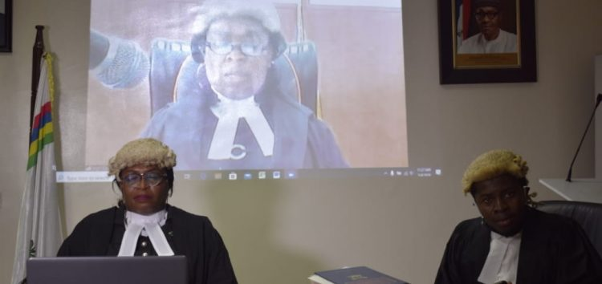
Rise of popularity in the year 2020 US, UK, India, Canada were among the first who started Virtual court in 2020. On march 24th in UK, England and wales were the first who launched Virtual Court. But the Virtual court was still limited for Civil Court Only.
Then on 12th may, at the Sheriffs Court in the cathedral city of Scotland; Iverness , they started Virtual court in a unique way. As the Courts in Scotland holds a jury ,they are using Cinema theatres as a “virtual Jury” which is not done by any other country.
Odeon Cinema theater in Ireland
On May 4 2020, at the Ikeja High Court, Lagos, Nigeria. The outcome of that case was the sentencing to death of a driver, Olalekan Hameed, for the murder of 76-year old Mrs Jolasun Okunsanya, on December 1, 2018

Slide 7
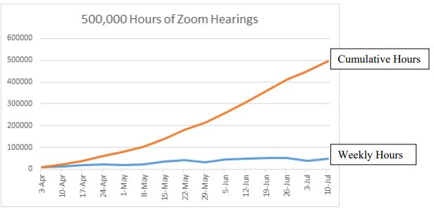
In the U.S., the Michigan state in April, 2020 started using Virtual Court more because of the pandemic. And it was recorded that from April 3rd to July 10, the state hit the mark of 500,000 hours of the virtual court hearing of countless different cases in Zoom. (Michigan Lawyers Weekly, 2020).

Slide 8
Virtual Court: How it started in Bangladesh?

Slide 9
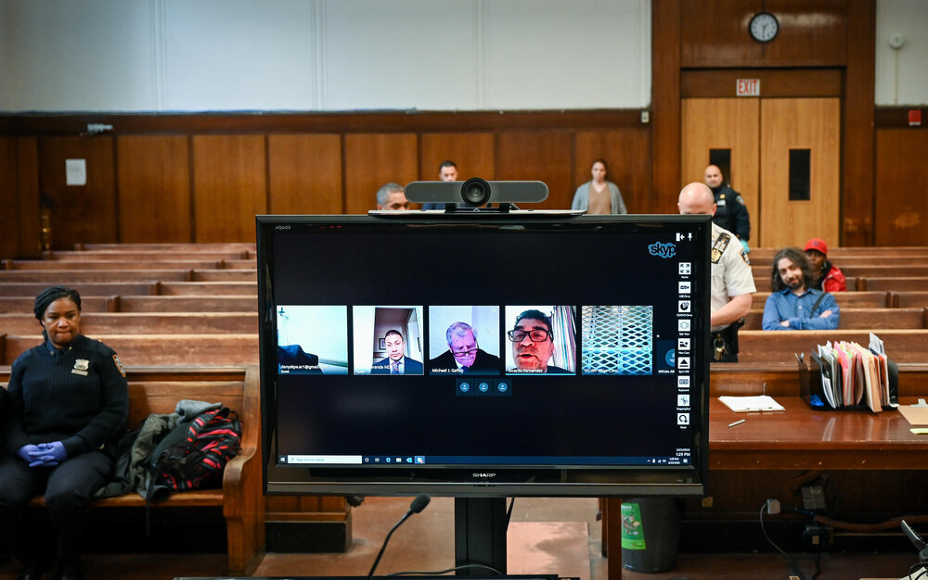
Virtual Court in Bangladesh:
During this pandemic, Bangladeshi judicial activities have been closed since March 26,2020.
Supreme Court took a historic decision to continue the court activities for emergency hearing and requested government for legal solution.
As a result Government and the Ministry of Law introduced the historical ordinance titled " The usage of Information and Technology in Court Ordinance 2020".
From May 10th to May 28th there were held virtual hearings for many cases and people were granted bail through virtual court.

Slide 10
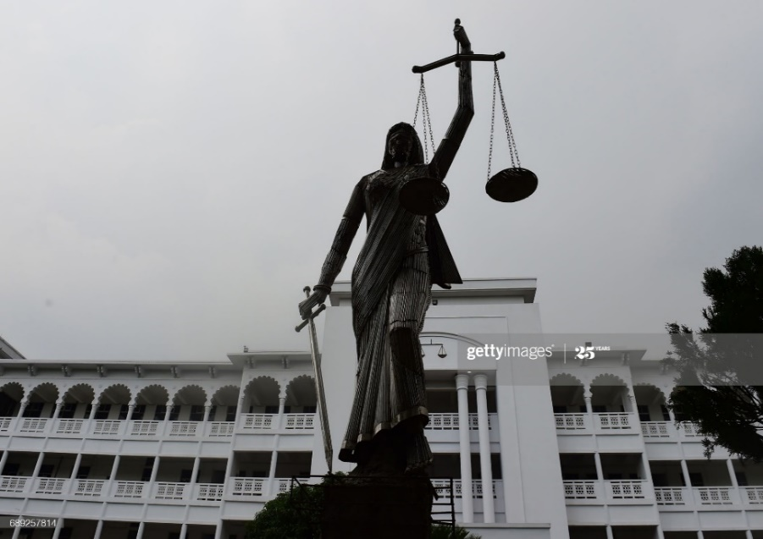
Virtual Court in Bangladesh:
Initially, it took huge efforts to set up apps, virtual courts strategy, prepare staffs, oblige attorneys and judges to complete legal handle through virtual court system.
These activities marked an new journey towards a sustainable e-judiciary system.
UNDP and ICT Division are working to develop the website of e-judiciary system.
By and large, the establishment of Virtual court framework in Bangladesh is very appreciating

Slide 11
Virtual Court: How lawyers, judges and people are receiving it?

Slide 12
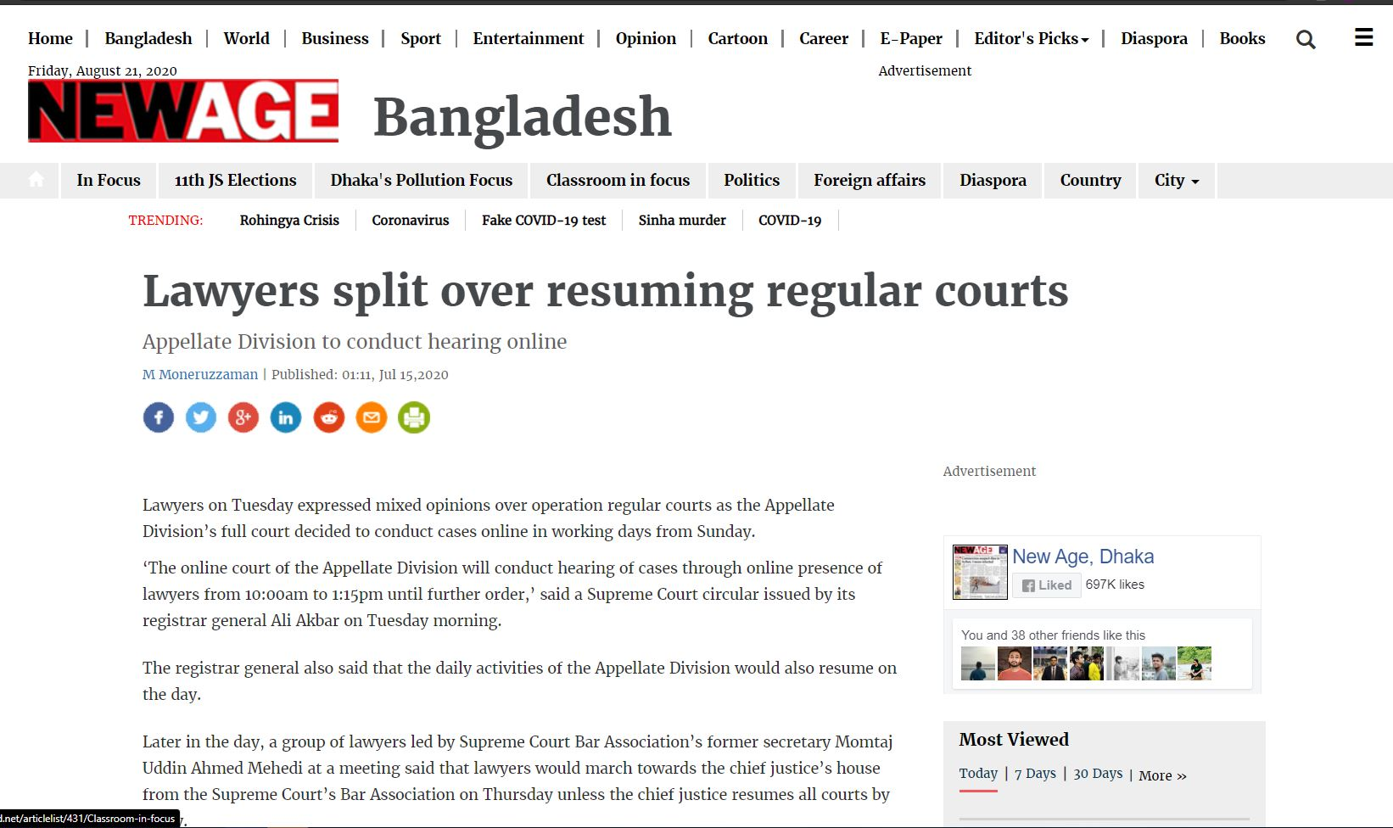
Reception:
President of AB bank expressed his satisfaction over virtual court proceedings ,in a metting of Lawers and Jurists Foundation.
Judges and Lawers have mixed feelings. Some lawers boycotted the virtual system, while others accepted it.
A judge from Chittagong district said , he was very much optimistic about virtual court

Slide 13
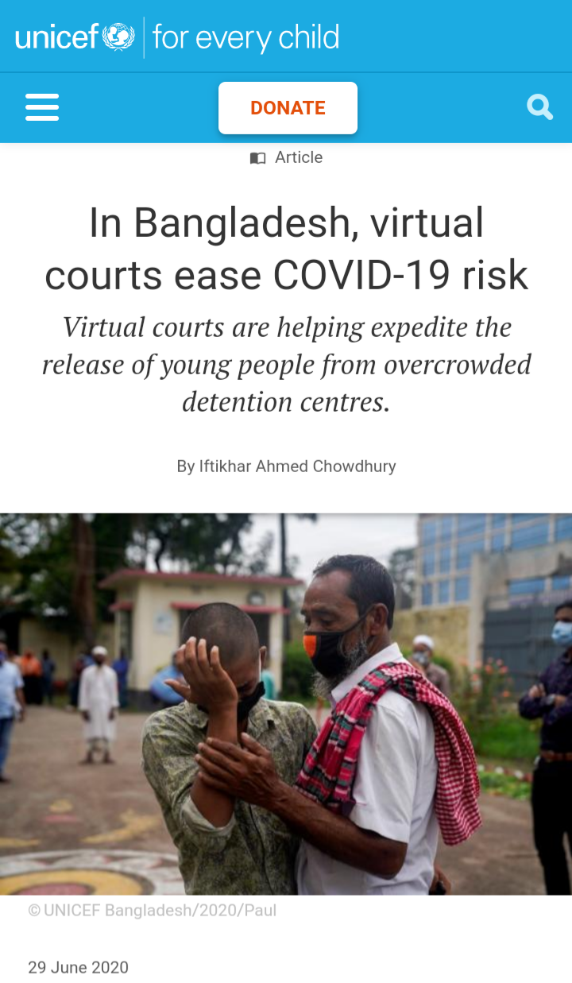
Reception:
Many lawers from rural area expressed their frustration, because they have to go to computer shop for court hearings, while risking virus contamination.
General people and Justice seeking people welcome the decision of Virtual court, they think that it will boost our Justice system and effective for emergency situations.

Slide 14
Virtual Court: Challenges
Lack of Training
Data Security
Less Human Interaction
Time Consuming
Slow Internet Connection

Slide 15
Virtual Court: Recommendation, Can we Overcome the challenges?

Slide 16
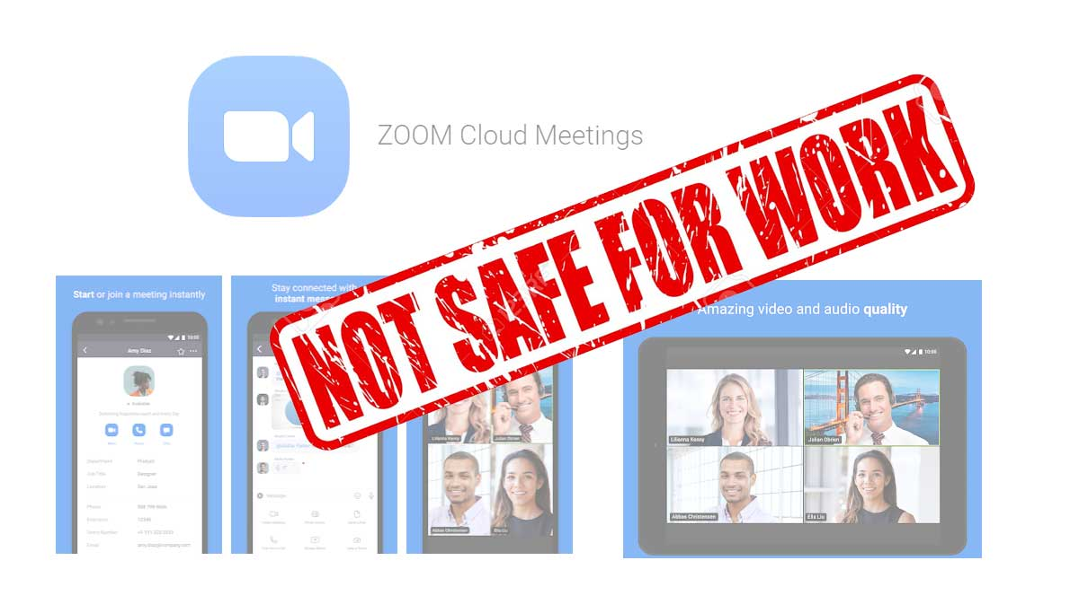

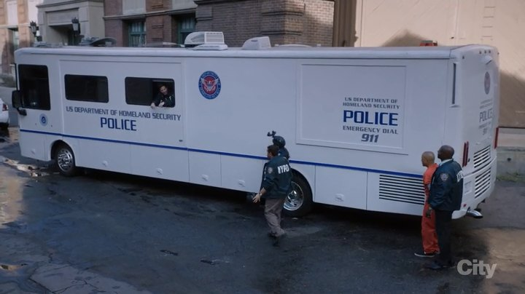



Specialized Software for Court.
Use of FOSS like India for cost savings.
Change Management backed by Training.
Lawyer Unions have a role to play
Mobile Command Center supported by state-of-the-art tech like drones

Slide 17
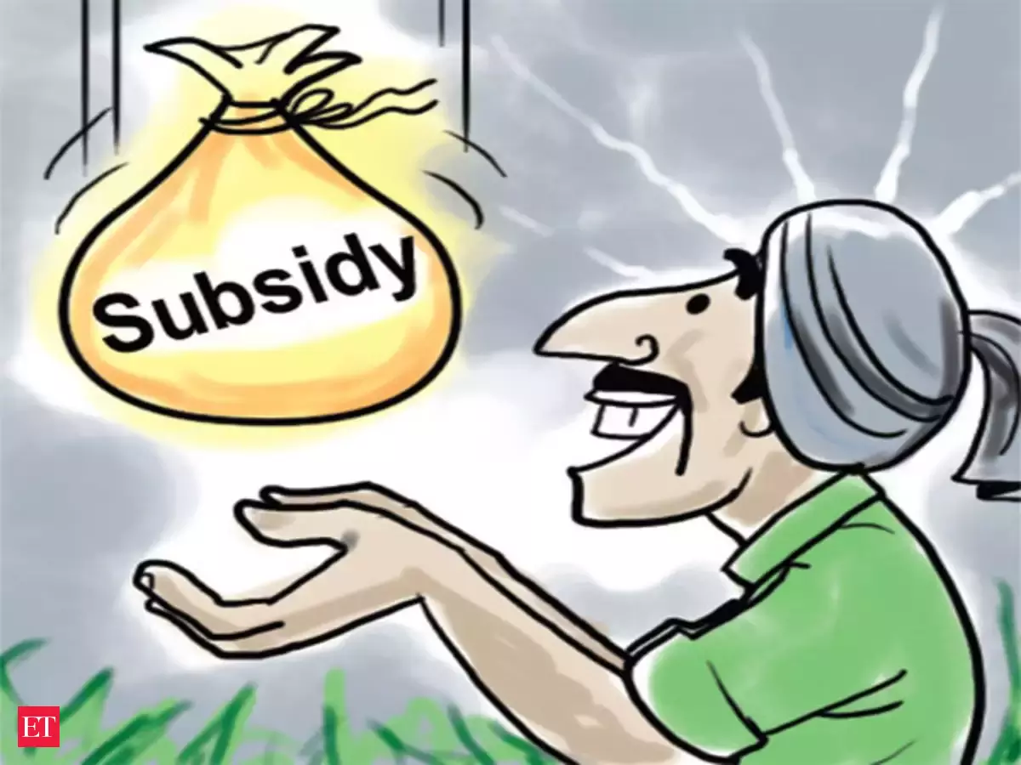


Subsidy for Strong Connection in the rural, remote places.
Modernization of State Facilities like Jails, Police Stations, Hospitals, Labs etc.
Sustainable, Continual Process will take time and money to shape everything, for our best.

